Slide 1
Inheritance in C++

Slide 2
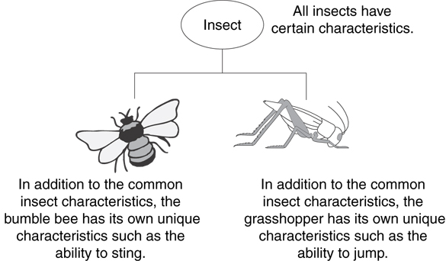
Example: Insect Taxonomy

Slide 3
C++ Inheritance
One of the most important concepts in object-oriented programming is that of inheritance. Inheritance allows us to define a class in terms of another class, which makes it easier to create and maintain an application. This also provides an opportunity to reuse the code functionality and fast implementation time.
When creating a class, instead of writing completely new data members and member functions, the programmer can designate that the new class should inherit the members of an existing class. This existing class is called the base class, and the new class is referred to as the derived class.

Slide 4
Inheritance
The language mechanism by which one class acquires the properties (data and operations) of another class
Base Class (or superclass): the class being inherited from
Derived Class (or subclass): the class that inherits

Slide 5
Advantages of inheritance
When a class inherits from another class, there are three benefits:
(1) You can reuse the methods and data of the existing class
(2) You can extend the existing class by adding new data and new methods
(3) You can modify the existing class by overloading its methods with your own implementations

Slide 6
The "is a" Relationship
Inheritance establishes an "is a" relationship between classes.
A poodle is a dog
A car is a vehicle
A flower is a plant
A football player is an athlete

Slide 7
Inheritance – Terminology and Notation in C++
Base class (or parent) – inherited from
Derived class (or child) – inherits from the base class
Notation:
class Student // base class
{
. . .
};
class UnderGrad : public student
{ // derived class
. . .
};

Slide 8
Back to the ‘is a’ Relationship
An object of a derived class 'is a(n)' object of the base class
Example:
an UnderGrad is a Student
a Mammal is an Animal
A derived object has all of the characteristics of the base class

Slide 9
C++ Protected Access Specifier
The access modifier protected is especially relevant when it comes to C++ inheritance.
Like private members, protected members are inaccessible outside of the class. However, they can be accessed by derived classes and friend classes/functions.
We need protected members if we want to hide the data of a class, but still want that data to be inherited by its derived classes.

Slide 10
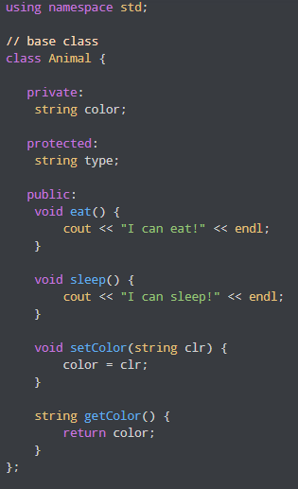
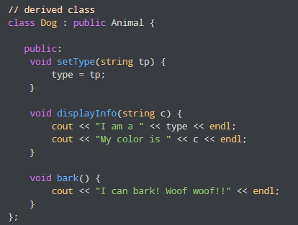
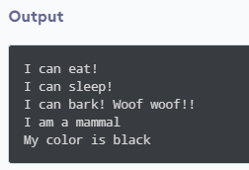
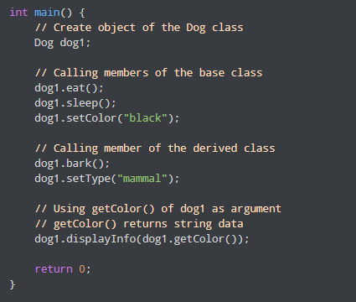
C++ Protected Access Specifier
Here, the variable type is protected and is thus accessible from the derived class Dog. We can see this as we have initialized type in the Dog class using the function setType().
On the other hand, the private variable color cannot be initialized in Dog.

Slide 11
Types of Inheritance
1. Single class Inheritance:
Single inheritance is the one where you have a single base class and a single derived class.
Class Employee
It is a Base class (super)
Class Manager
it is a sub class (derived)

Slide 12
#include <iostream>
using namespace std;
class base //single base class
{
public:
int x;
void getdata()
{
cout << "Enter the value of x = "; cin >> x;
}
};
class derive : public base //single derived class
{
private:
int y;
public:
void readdata()
{
cout << "Enter the value of y = "; cin >> y;
}
void product()
{
cout << "Product = " << x * y;
} };
int main()
{
derive a; //object of derived class
a.getdata();
a.readdata();
a.product();
return 0;
}
OUTPUT:
Enter the value of x = 3
Enter the value of y = 4
Product = 12

Slide 13
Types of Inheritance
2. Multilevel Inheritance:
In Multi level inheritance, a class inherits its properties from another derived class.
Class A
it is a Base class (super) of B
Class B
it is a sub class (derived) of A
and base class of class C
Class C
derived class(sub) of class B

Slide 14
// Base class (parent) class A { public: void myFunction() { cout << "Some content in parent class." ; } }; // Derived class (child) class B: public A {
//some operation }; // Derived class (grandchild) class C: public B {
//some operation }; int main() { C myObj; myObj.myFunction(); return 0; }

Slide 15
Types of Inheritance
3. Multiple Inheritances:
In Multiple inheritances, a derived class inherits from multiple base classes. It has properties of both the base classes.
Class A
Class B
Base class
Class C
Derived class

Slide 16
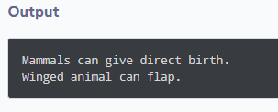
#include <iostream>
using namespace std;
class Mammal {
public:
Mammal() {
cout << "Mammals can give direct birth." << endl;
}
};
class WingedAnimal {
public:
() {
WingedAnimal cout << "Winged animal can flap." << endl;
}
};
class Bat: public Mammal, public WingedAnimal {
Public:
Somemethod(){};
};
int main() {
Bat b1;
return 0;
}

Slide 17


Types of Inheritance
4. Hierarchical Inheritance:
In hierarchical Inheritance, it's like an inverted tree. So multiple classes inherit from a single base class. It's quite analogous to the File system in a unix based system.
Class A
Class B
Class D
Class C

Slide 18
#include <iostream>
// Base class
class Shape {
public:
void draw() {
std::cout << "Drawing a generic shape." << std::endl;
}
};
// Derived class Rectangle inheriting from Shape
class Rectangle : public Shape {
public:
void draw() {
std::cout << "Drawing a rectangle." << std::endl;
}
};
// Derived class Circle inheriting from Shape
class Circle : public Shape {
public:
void draw() {
std::cout << "Drawing a circle." << std::endl;
}
};
Function Overriding
int main() {
// Create objects of the derived classes
Rectangle rec1;
Circle cir1;
Shape sh1;
Sh1.draw();
// Call the draw() function of the objects
rec1.draw(); // Output: "Drawing a rectangle."
cir1.draw(); // Output: "Drawing a circle."
// Call the draw() function of the base class through the derived class objects
rec1.Shape::draw(); // Output: "Drawing a generic shape."
cir1.Shape::draw(); // Output: "Drawing a generic shape."
return 0;
}

Slide 19
Function Overriding
Function overriding is a concept in C++ that allows a derived class to provide a specific implementation for a method that is already defined in its base class. When a function is overridden in the derived class, the derived class's version of the function takes precedence over the base class's version when called through a derived class object.
To achieve function overriding, the base class function must be declared as virtual, and the derived class function must have the same function signature (name, return type, and parameters) as the base class function.

Slide 20
Types of Inheritance
5. Hybrid Inheritance:
In this type of inheritance, we can have mixture of number of inheritances but this can generate an error of using same name function from no of classes, which will bother the compiler to how to use the functions.
Therefore, it will generate errors in the program. This has known as ambiguity or duplicity.
Ambiguity problem can be solved by using virtual base classes

Slide 21
Types of Inheritance
5. Hybrid Inheritance:
Class A
Class B
Class C
Class D

Slide 22
Here, when D inherits from multiple classes;
B and C having the same base class; A,
it may inherit multiple instances of the base class. This is known as the diamond problem.
We can avoid this problem using virtual inheritance.

Slide 23
class Base {
... .. ...
};
class Derived1 : virtual public Base {
... .. ...
};
class Derived2 : virtual public Base {
... .. ...
};
class Derived3 : public Derived1, public Derived2 {
... ... ...
};
Here, Derived1 and Derived2 both inherit from Base virtually, ensuring that Derived3 will have only one set of Base member variables, even though it inherits from both Derived1 and Derived2.

Slide 24
#include <iostream>
using namespace std;
// base class with a speciesName member variable
class Animal {
private:
string species_name;
public:
// constructor that accepts
// a species name for initialization
Animal(const string& name) : species_name(name) {
cout << "Animal constructor called" << endl;
}
void show_species() const {
cout << "This animal belongs to the species: " << species_name << endl;
}
};

Slide 25
/ WingedAnimal class with virtual inheritance from Animal
class WingedAnimal : virtual public Animal {
public:
// constructor that initializes
// the Animal part of WingedAnimal
WingedAnimal(const string& name) : Animal(name) {
cout << "WingedAnimal constructor called" << endl;
}
};
// Mammal class with virtual inheritance from Animal
class Mammal : virtual public Animal {
public:
// constructor that initializes
// the Animal part of Mammal
Mammal(const string& name) : Animal(name) {
cout << "Mammals constructor called" << endl;
}
};

Slide 26
// Bat class inherits from WingedAnimal and Mammal
class Bat : public WingedAnimal, public Mammal {
public:
// Bat constructor
// note that Animal's constructor will only be called once
// due to virtual inheritance.
Bat() : Animal("Bat"), WingedAnimal("Bat"), Mammal("Bat") {
}
void show_info() {
cout << endl << "It's a unique animal! Here are some details:" << endl;
// show the species_name
// demonstrating the shared member variable
show_species();
}
};
int main() {
Bat my_bat;
my_bat.show_info();
return 0;
}

Slide 27
Output
Animal constructor called
WingedAnimal constructor called
Mammals constructor called
It's a unique animal! Here are some details:
This animal belongs to the species: Bat

Slide 28
Virtual Functions
A virtual function (also known as virtual methods) is a member function that is declared within a base class and is re-defined (overridden) by a derived class. When you refer to a derived class object using a pointer or a reference to the base class, you can call a virtual function for that object and execute the derived class’s version of the method.
Virtual functions ensure that the correct function is called for an object, regardless of the type of reference (or pointer) used for the function call.
They are mainly used to achieve Runtime polymorphism.
Functions are declared with a virtual keyword in a base class.
The resolving of a function call is done at runtime.

Slide 29
Rules for Virtual Functions
The rules for the virtual functions in C++ are as follows:
Virtual functions cannot be static.
A virtual function can be a friend function of another class.
Virtual functions should be accessed using a pointer or reference of base class type to achieve runtime polymorphism.
The prototype of virtual functions should be the same in the base as well as the derived class.
They are always defined in the base class and overridden in a derived class. It is not mandatory for the derived class to override (or re-define the virtual function), in that case, the base class version of the function is used.
A class may have a virtual destructor but it cannot have a virtual constructor.

Slide 30
#include <iostream>
using namespace std;
class base {
public:
virtual void print() { cout << "print base class\n"; }
void show() { cout << "show base class\n"; }
};
class derived : public base {
public:
void print() { cout << "print derived class\n"; }
void show() { cout << "show derived class\n"; }
};

Slide 31
int main()
{
base* bptr;
derived d;
bptr = &d;
// Virtual function, binded at runtime
bptr->print();
// Non-virtual function, binded at compile time
bptr->show();
return 0;
}
print derived class
show base class

Slide 32
// C++ program to illustrate
// working of Virtual Functions
#include <iostream>
using namespace std;
class base {
public:
void fun_1() { cout << "base-1\n"; }
virtual void fun_2() { cout << "base-2\n"; }
virtual void fun_3() { cout << "base-3\n"; }
virtual void fun_4() { cout << "base-4\n"; }
};
class derived : public base {
public:
void fun_1() { cout << "derived-1\n"; }
void fun_2() { cout << "derived-2\n"; }
void fun_4(int x) { cout << "derived-4\n"; }
};

Slide 33
int main()
{
base* p;
derived obj1;
p = &obj1;
// Early binding because fun1() is non-virtual
// in base
p->fun_1();
// Late binding (RTP)
p->fun_2();
// Late binding (RTP)
p->fun_3();
// Late binding (RTP)
p->fun_4();
// Early binding but this function call is
// illegal (produces error) because pointer
// is of base type and function is of
// derived class
// p->fun_4(5);
return 0;
}
Output:
base-1
derived-2
base-3
base-4

Slide 34
Thank You!!!

